Slide 1

AAKRUTI Global 2024
Bharati Vidyapeeth’s College of Engineering for Women, Pune
Team Name: MDSA Smart City Pioneers
Team ID: AG24-1400747

Slide 2





Meet the Team
Mitali Rajesh Chavan
Diti Jariwala
Sanika Chaudhari
Anushruti Adhikari

Slide 3

Our Mentor
Prof. Pranoti Kale

Slide 4
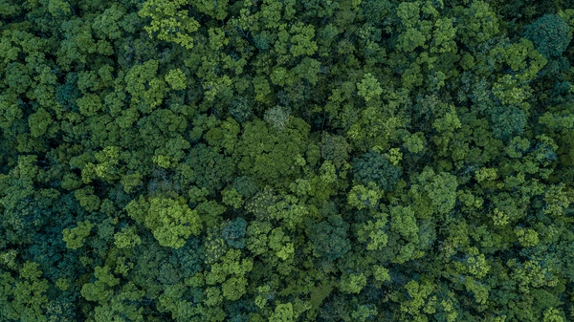
Sustainable Habitat/ City Infrastructure

Slide 5
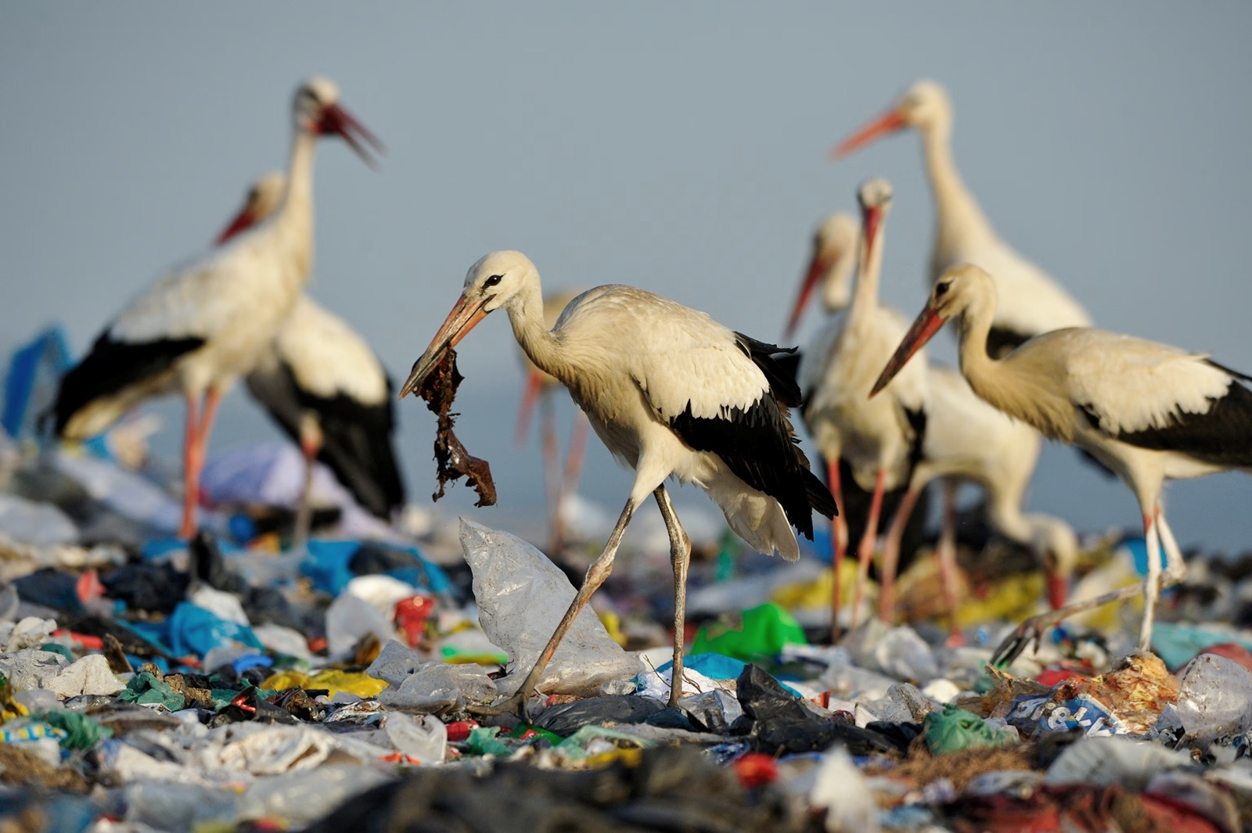
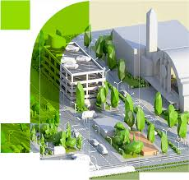
Problem Statement
Urban residential societies are grappling with inefficient waste management, leading to environmental degradation and resource depletion. This project aims to create a sustainable waste management system using advanced AI and ML technologies for automated segregation of biodegradable and non-biodegradable waste. Biodegradable waste will be converted into odorless compost for local landscaping, while non-biodegradable waste will be directed to recycling facilities. This comprehensive approach seeks to minimize environmental impact, conserve resources, and promote sustainability in urban habitats.

Slide 6
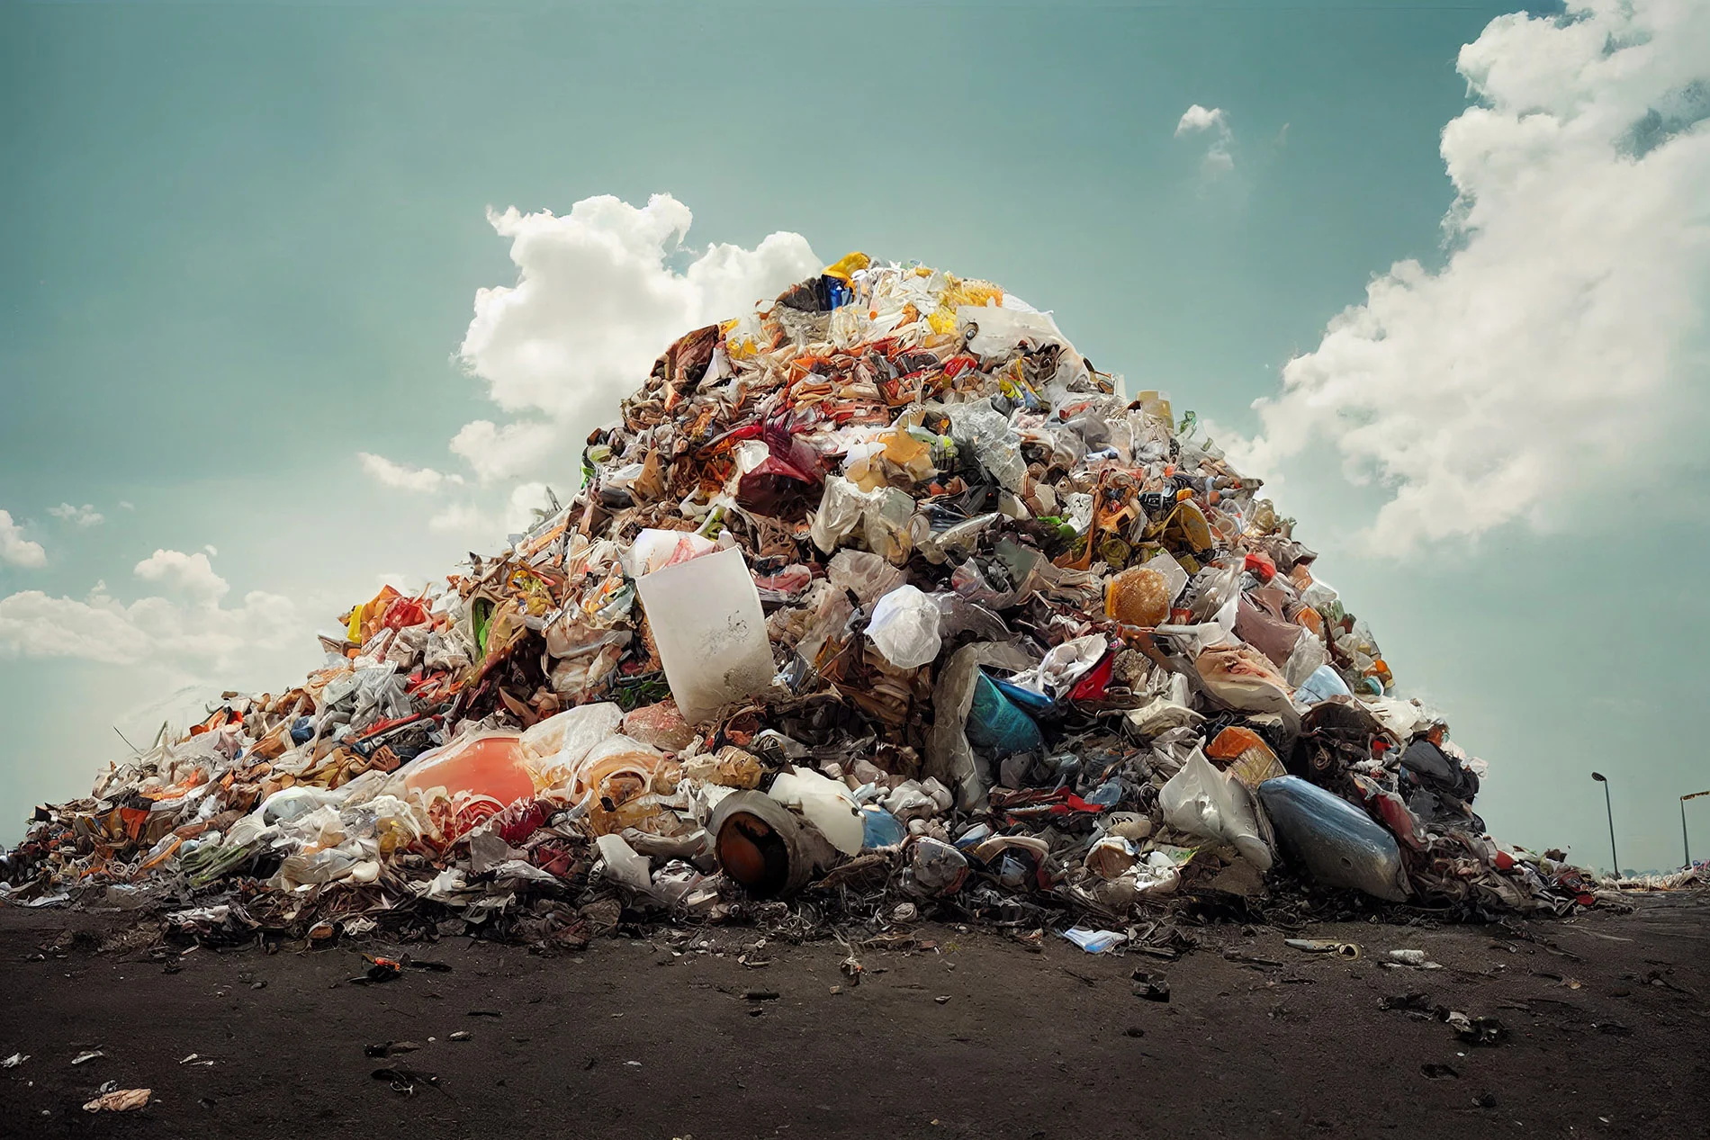
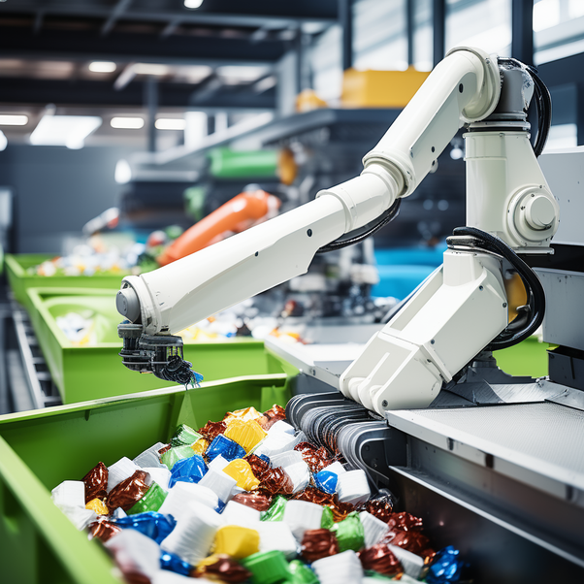
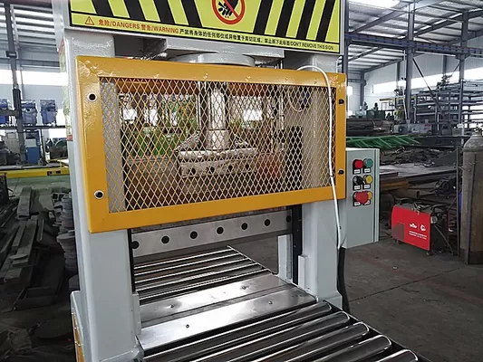
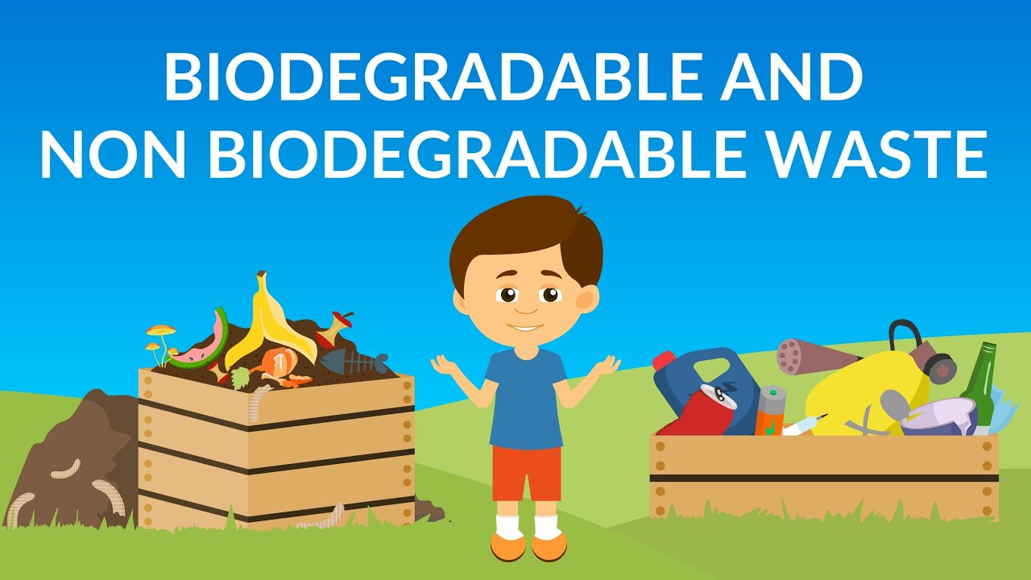
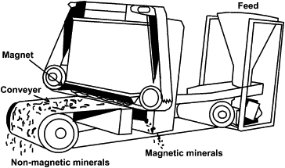
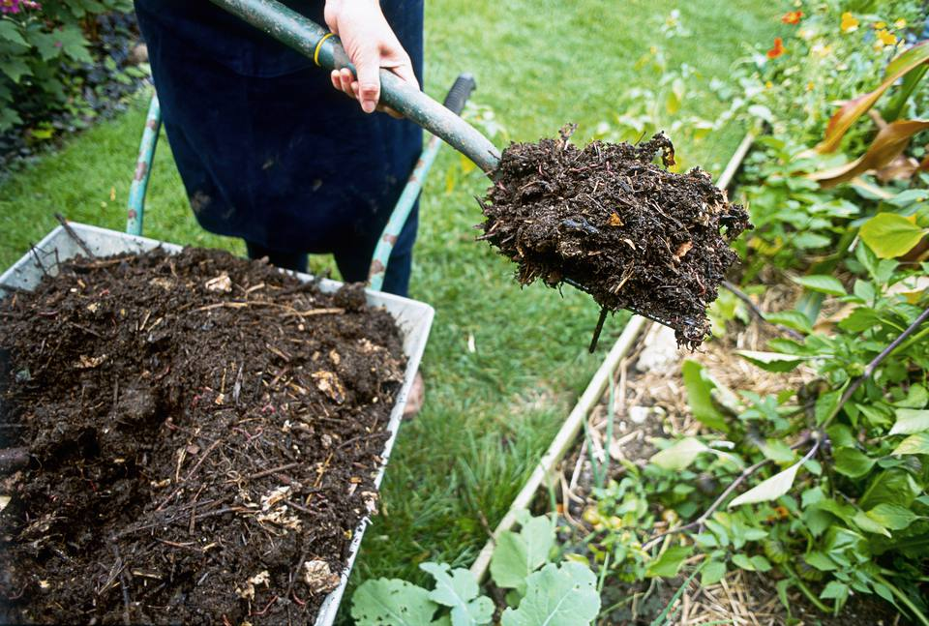
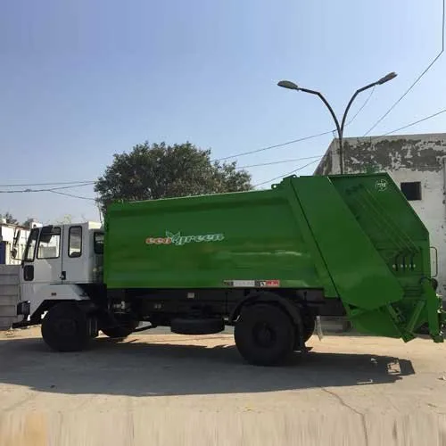
Waste Input
Robotic Arm Picking and Conveyor Belt Transfer
Cutting the entangled items to separate them using IR Scanner
Segregating Waste into Biodegradable and Non-Biodegradable
Magnetic Separation
Biodegradable waste converted to Compost
Non-Biodegradable waste transferred to authorities for further processing and disposal

Slide 7
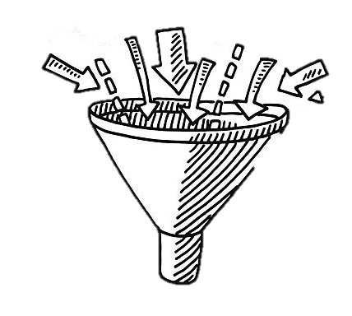
Step 1: Waste Input
All the residential waste (unsegregated) is dumped into the machine via an openable outlet which will collect the waste in a bin.

Slide 8
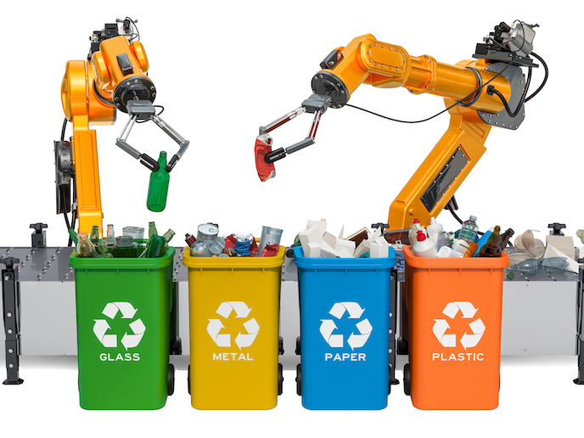
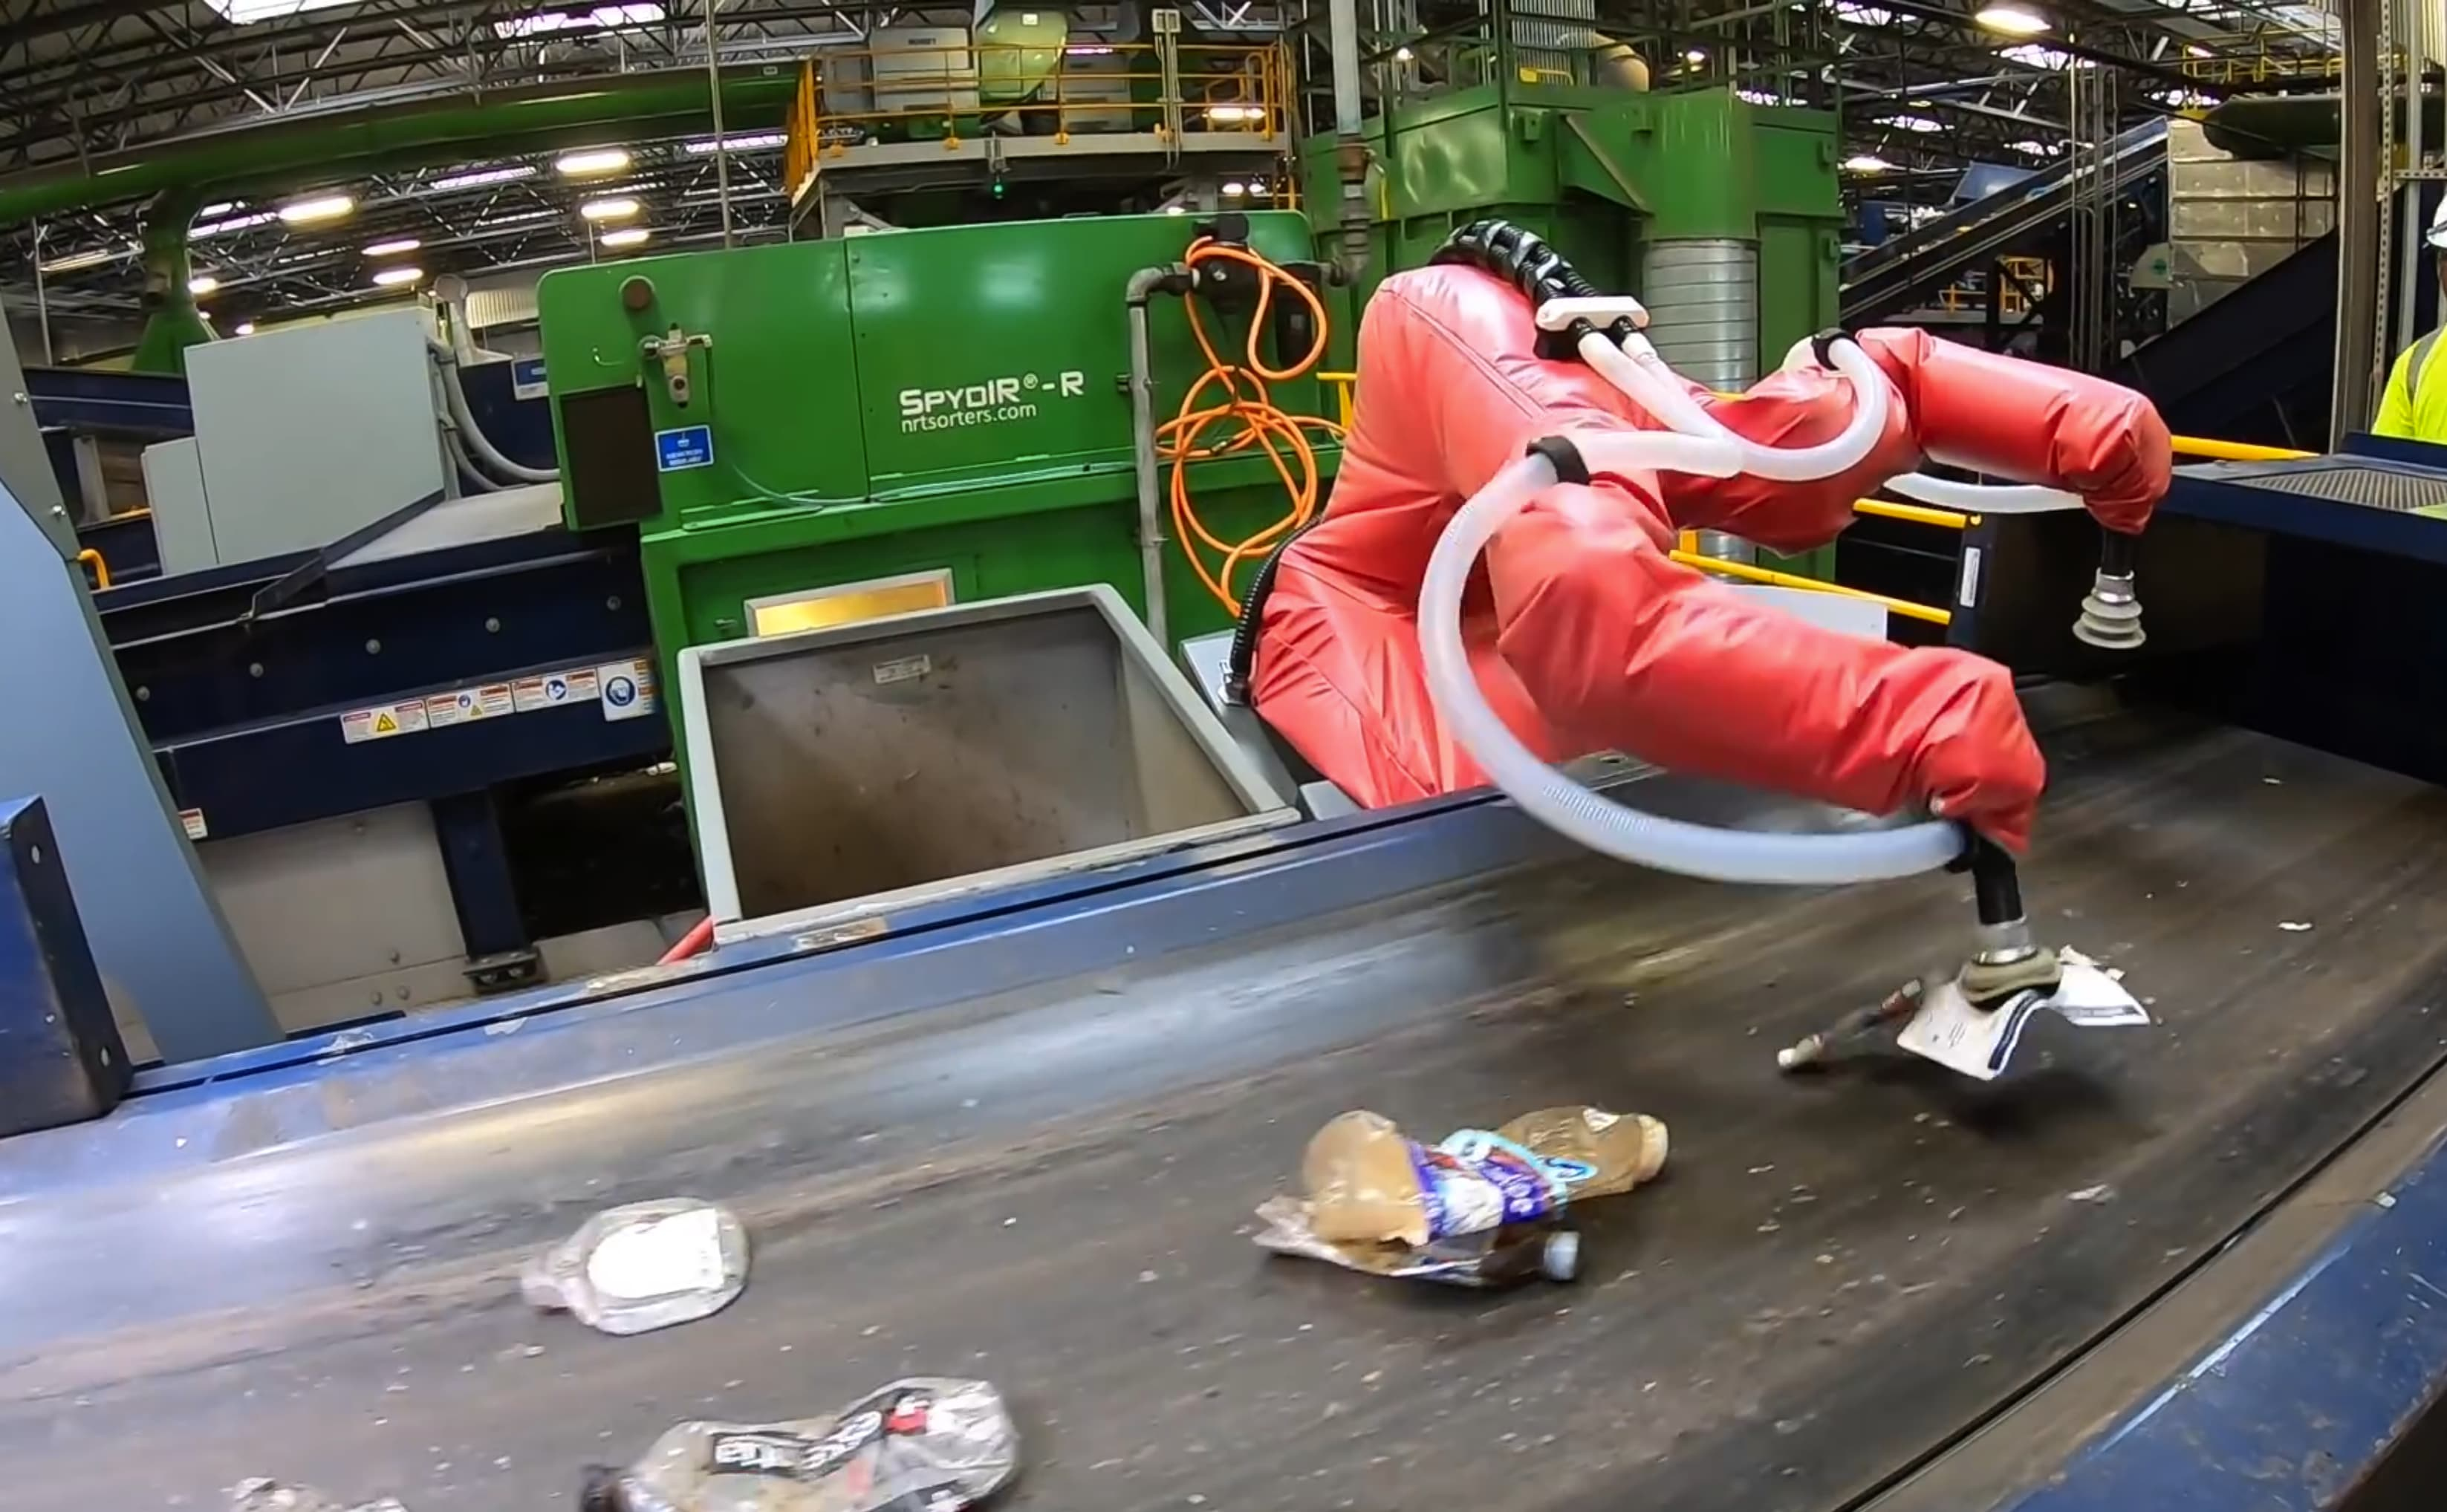
Step 2: Robotic Arm Picking and Conveyor Belt Transfer
The robotic arm one by one picks up the waste from the bin
It then places the picked waste material onto a conveyor belt

Slide 9
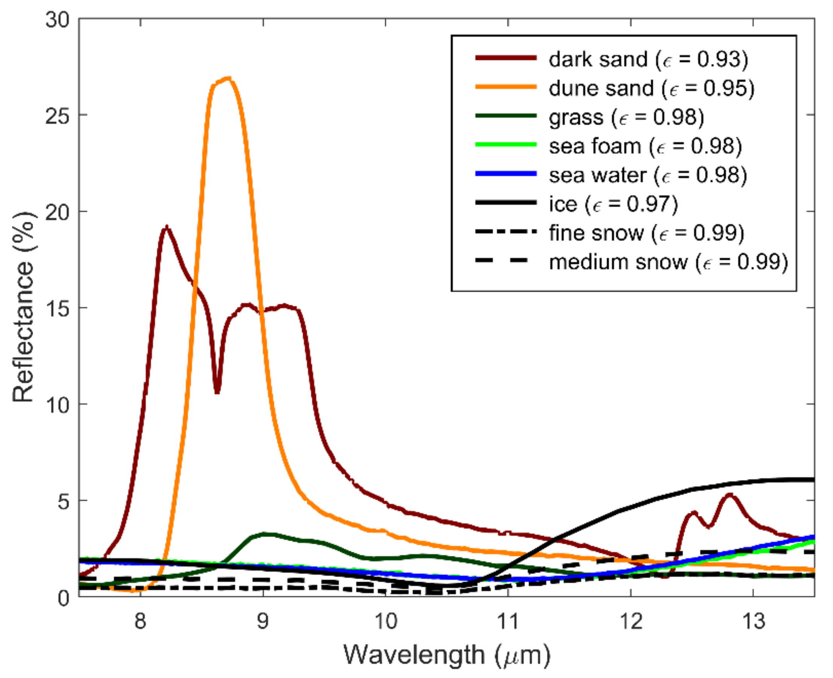
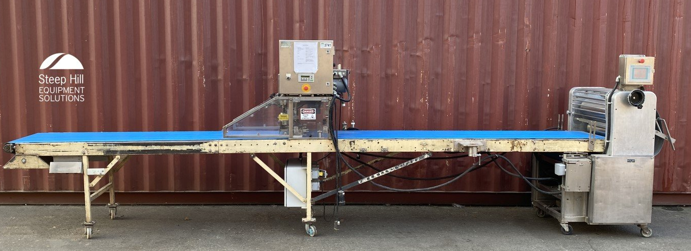
Step 3: Cutting the entangled items to separate them using IR Scanner
To ensure that the 2 different objects are not entangled, we cut them using 3 blades
(1 vertical and 2 horizontal)
IR sensor can immediately detect a different object.

Slide 10
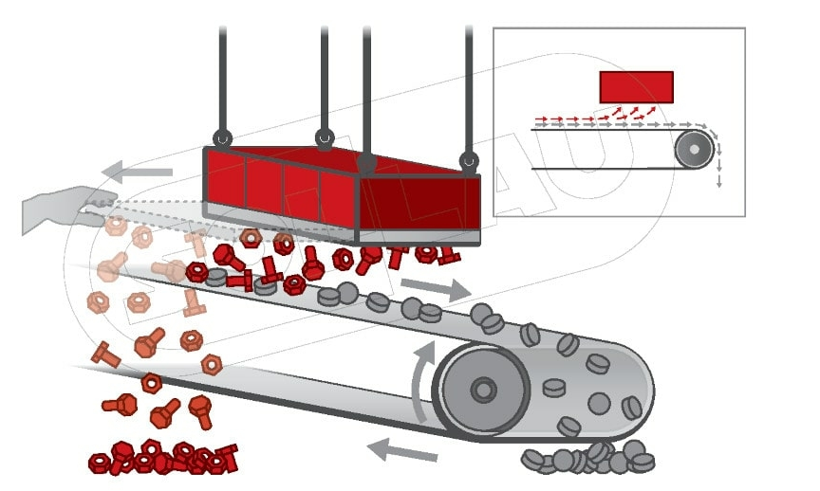
Step 4: Magnetic Separation
We will now use an electric magnet to separate the magnetic waste from the rest of the waste by using a movable aerial shaft.

Slide 11
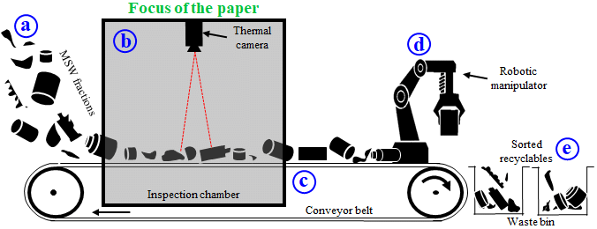
Step 5a: Segregating Waste into Biodegradable and Non-Biodegradable
(a) Infrared Thermography
Infrared thermography is a non-contact, remote sensing technique that detects infrared radiation (heat) emitted by objects and creates thermal images based on temperature variations.
1. Thermal Imaging Cameras:- Place infrared cameras along the conveyor belt to capture thermal images of moving waste.
2. Temperature Profiling:- Identify materials based on their heat emissions, with biodegradable materials typically appearing warmer due to higher moisture content and decomposition heat, while non-biodegradable materials appear cooler with distinct thermal patterns.
3. Data Processing and Analysis:- Use software to analyze thermal images in real-time, identifying patterns and temperature differences for accurate waste sorting.
4. Automated Sorting Mechanism:- Install actuators or diverters along the conveyor belt to direct biodegradable and non-biodegradable waste into separate bins based on thermal imaging data.

Slide 12
Benefits
Challenges
Non-Contact Method
Initial Cost
1.
1.
Real Time Analysis
Calibration and Maintenance
2.
2.
Accuracy
Environmental Factors
3.
3.
Adaptability
Training and Expertise
4.
4.

Slide 13
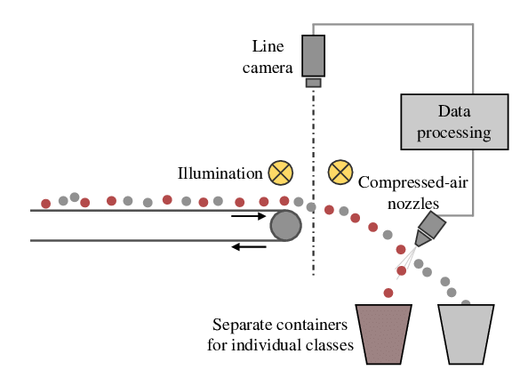
Step 5b: Segregating Waste into Biodegradable and Non-Biodegradable
(b) Optical Sorting
Optical sorting is a high-tech method of sorting waste materials using advanced sensors, cameras, and software algorithms. It relies on the optical properties of materials to identify and separate different types of waste, such as biodegradable and non-biodegradable items.
1. Conveyor Belt System:- Use the conveyor belt on which the waste material flow.
2. High-Resolution Cameras and Sensors:- It Can include visible light cameras, near-infrared (NIR) sensors, ultraviolet (UV) sensors, and hyperspectral imaging systems. This helps to detect various optical properties such as color, shape, size, and material composition.
3. Data Processing and Analysis:- Use machine learning and artificial intelligence to analyze the captured data, identify material types, and classify waste accurately.
4. Automated Sorting Mechanisms:- It include air jets , Mechanical Arms and Diverters, which can be used to sort or divert the waste.

Slide 14
Benefits
Challenges
High Accuracy
Initial Cost
1.
1.
Efficiency
Calibration and Maintenance
2.
2.
Versatility
Environmental Factors
3.
3.
Non-Contact Method
Complexity
4.
4.
Data Collection
5.

Slide 15
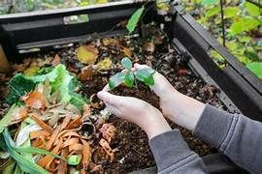
Step 6: Composting
Composting is a great way to recycle organic waste and enrich your garden soil. Our design is to turn food waste into ready-to-use compost. It typically takes less than 24 hours to process food scraps into homemade fertilizer. This device uses a combination of mechanical grinding and an additive to accelerate the decomposition process, making it much faster than traditional composting methods.
Process:
Step 1: Loading Waste.
Step 2: Adding Additives.
Step 3: Grinding and Mixing.
Step 4: Aeration.
Step 5: Processing Time.
Step 6: Compost Collection.

Slide 16
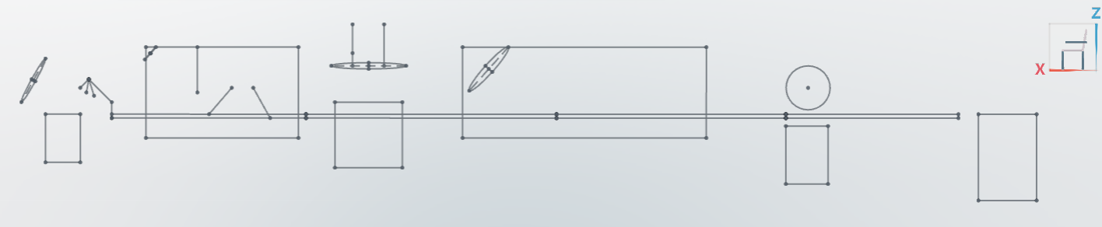
System Design
Disentangling Chamber
Robotic Arm
Infrared Scanner
Magnetic Axle
Segregation Chamber
Piston
Waste Input
Conveyor Belt
Magnetic Waste Collector
Infrared Cameras Capturing Thermal Image
Non-Biodegradable Waste
Biodegradable Waste/Composting Unit
Waste Collector
Cutters

Slide 17
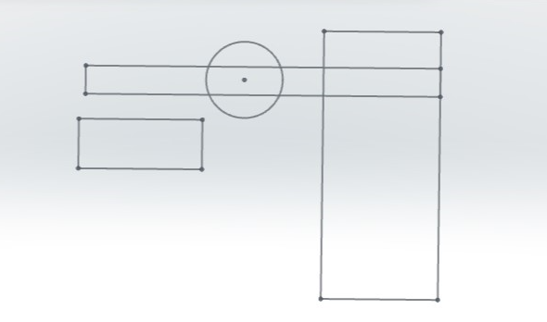
Ariel View
Conveyor Belt
Axle
Magnetic Waste Collector
Magnet

Slide 18
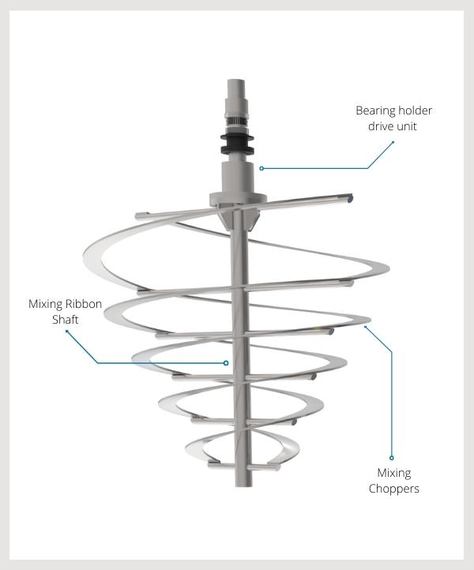
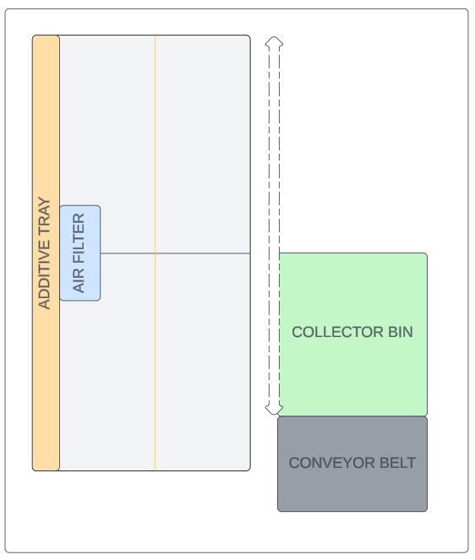
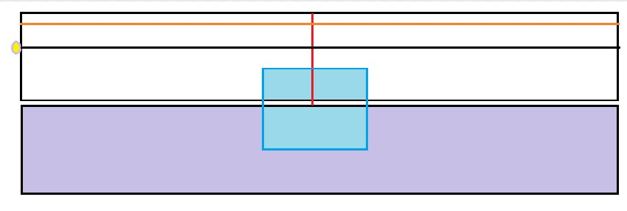
Compost Unit Design
Start, Stop and Pause Buttons
Tray to add additives
Air Filter

Slide 19

Approximate Budget
Sr. No. | Component | Estimated Price
1 | Waste Input (Input Hatch and Motor, Waste Bin) | 15,000
2 | Robotic Arm Picking and Conveyor Belt (Robotic Arm, Conveyor Belt, Motor and Control System) | 80,000
3. | Disentangling (IR Scanner, Cutting Mechanism Blades and Motor) | 30,000
4. | Magnetic Separation (Electric Magnet, Movable Aerial Shift) | 20,000
5. | Thermal Segregation (Thermal Image Cameras, Actuators and Divertors) | 63,000
6. | Composting Unit (Bin, Mixing Blades and Mechanism, Air Filter, Additive Loft, Control Panel) | 35,000
 | Total | 2,43,000

Slide 20
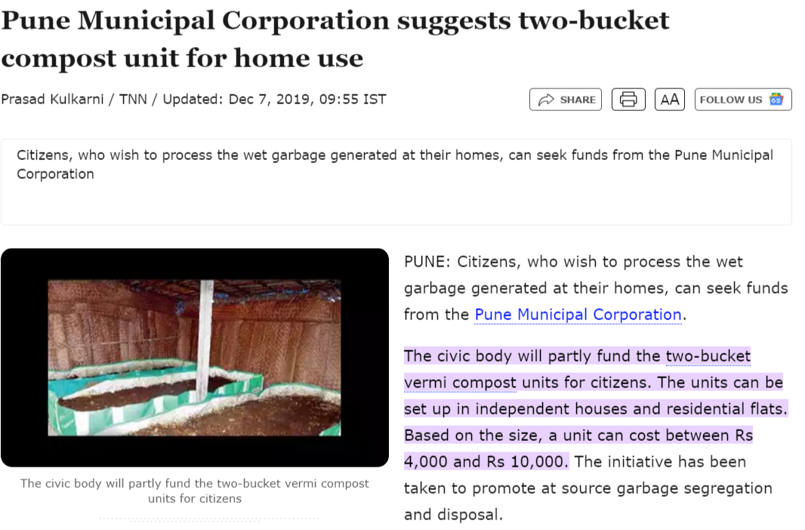

Slide 21
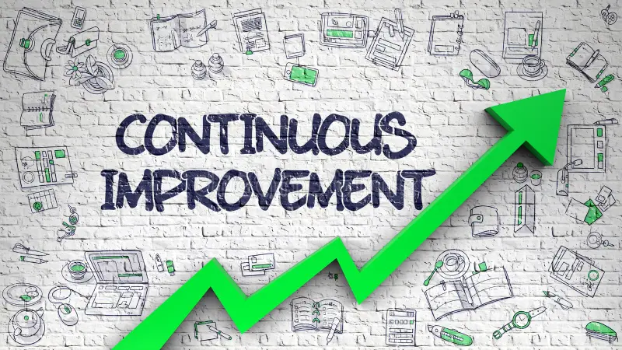
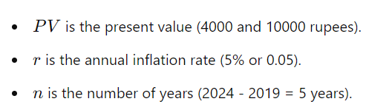
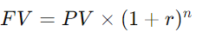
Future Value Formula:
Only Composting
Year | Number of Houses | Cost | Cost per house | Equivalent value in 2024
2019 | 1 | 4,000.00 | 4,000.00 | 5,105.13
2019 | 1 | 10,000.00 | 10,000.00 | 12,762.82
2024 | 500 | 2,43,000.00 | 486.00 | 486.00
Segregation and Composting

Slide 22


